Slide 1
CS 585 Final Project
Shubhangi Jain
Shoumik Majumdar

Slide 2
Objective
Chest X-Ray scans classification for classifying COVID19 patients.

Slide 3
Binary Classification
Classification of chest X-Ray scans between COVID19 patient and NORMAL people.
Worked on 130 X-Rays scans from the publicly available dataset by the University of Montreal.

Slide 4
Approach
Used 4 models to train the X-Ray scan dataset
Self implemented model
VGG16
VGG19
ResNet50

Slide 5
Binary Baseline Results
Model | Train_Accuracy | Loss | Validation accuracy | Loss
Self Created | 75% | 0.5274 | 65% | 0.8279
VGG16 | 94% | 0.1394 | 90% | 0.1839
VGG19 | 92% | 0.1730 | 95% | 0.0675
ResNet50 | 97% | 0.2269 | 50% | 3.8716

Slide 6
Binary Classification Results

Slide 7
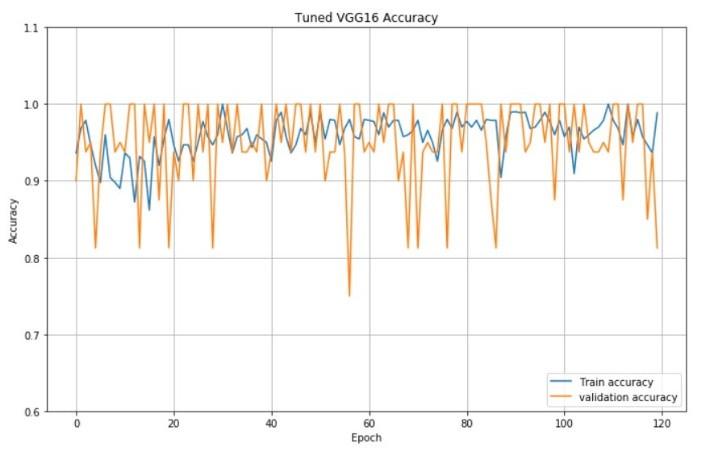
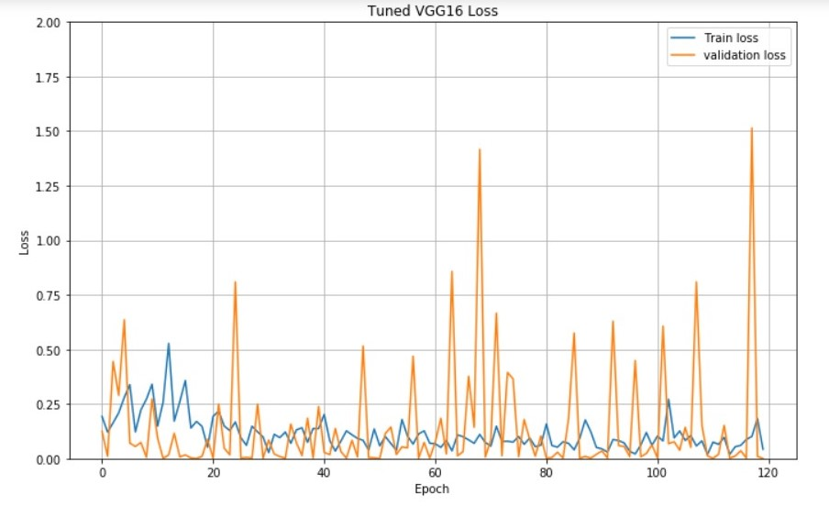
VGG16 Model
Train accuracy = 98.86% , Train loss = 0.0385
Validation accuracy = 81.25%, Validation loss= 1.54e-04
Test accuracy: 83.33%
Test accuracy: 0.8333333134651184
Zz zzzzzzzzzzzzzzzzzzzzzzz

Slide 8
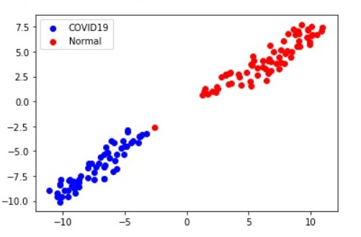
Lower Dimension Plot for VGG16

Slide 9
Multi Class Classification
Classification of chest X-Ray scans among COVID19 patients, NORMAL patients, Bacterial Pneumonia patients and Viral Pneumonia patients
Worked on 270 X-Rays scans from the publicly available dataset by the University of Montreal.

Slide 10
Approach
Used 5 models to train the X-Ray scan dataset
Self implemented model
VGG16
InceptionResNetV2
ResNet50
Xception

Slide 11
Multiclass Classification Results

Slide 12
MultiClass Baseline Results
Model | Train_Accuracy | Loss | Validation accuracy | Loss
Self Created | 51% | 1.1029 | 52% | 0.9131
VGG16 | 78% | 0.5492 | 68% | 1.1259
InceptionResNetV2 | 76% | 0.5736 | 32% | 3.8653
ResNet50 | 81% | 0.3685 | 41% | 4.1713
Xception | 76% | 0.5768 | 39% | 2.2838

Slide 13
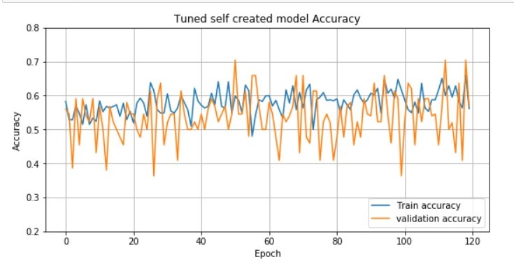
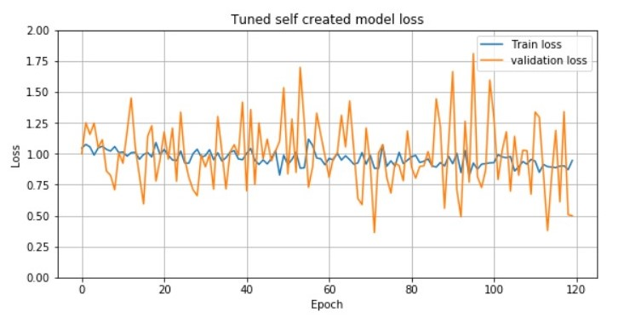
Self Created Model
Train accuracy = 56.19% , Train loss = 0.9462
Validation accuracy = 56.82%, Validation loss= 0.4992
Test Accuracy = 41.6%

Slide 14
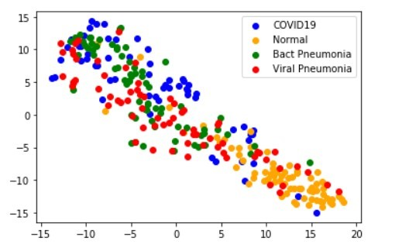
Lower Dimension Plot(Self Created)

Slide 15
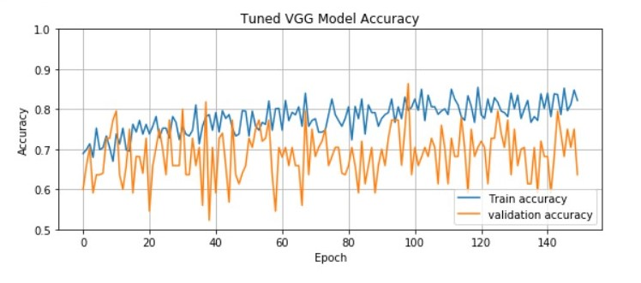
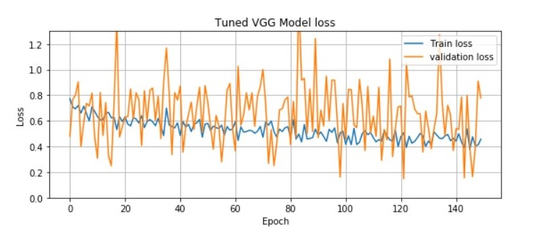
VGG16 Model
Train accuracy = 82.18% , Train loss = 0.4535
Validation accuracy = 63.64%, Validation loss = 0.7785
Test Accuracy = 72.2%

Slide 16
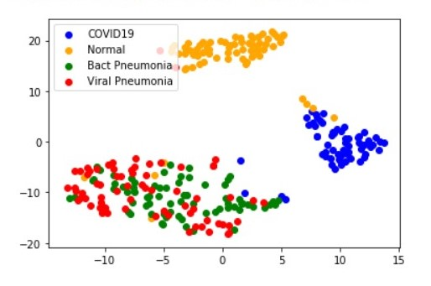
Lower Dimension Plot(VGG16)

Slide 17
Conclusion
For the Binary Class, VGG16 performed the best.
VGG19 can also be explored.
For Multi Class, VGG16 performed the best.
ResNet50 in both problems had very good training accuracy but poor generalization.
This model could be further explored by stronger regularization and training for more epochs.

Slide 18
Thank you

